Slide 1
Project 2: HDB price prediction
Presenter: Yap Yeong Cherng

Slide 2
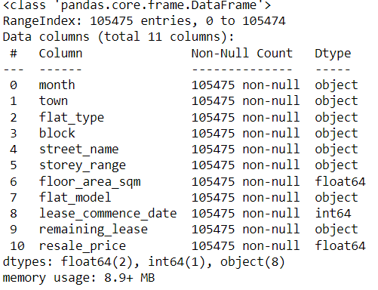
Question / Dataset
Does HDB resale price follow an increasing trend ?
Can we predict this trend ?
Dataset: HDB_Resale_prices 2017-2021aug
Kaggle: https://www.kaggle.com/laifookfatt/hdb-resale-prices-20172021aug/version/1?select=resale-flat-prices-based-on-registration-date-from-jan-2017-onwards.csv

Slide 3
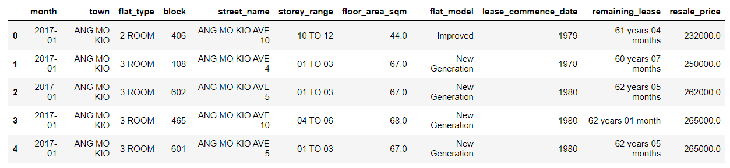
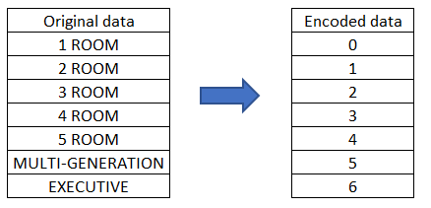
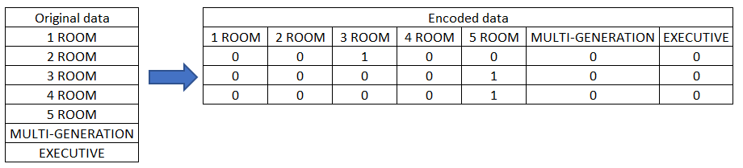
Data preparation
Encoding test 1
Encoding test 2

Slide 4

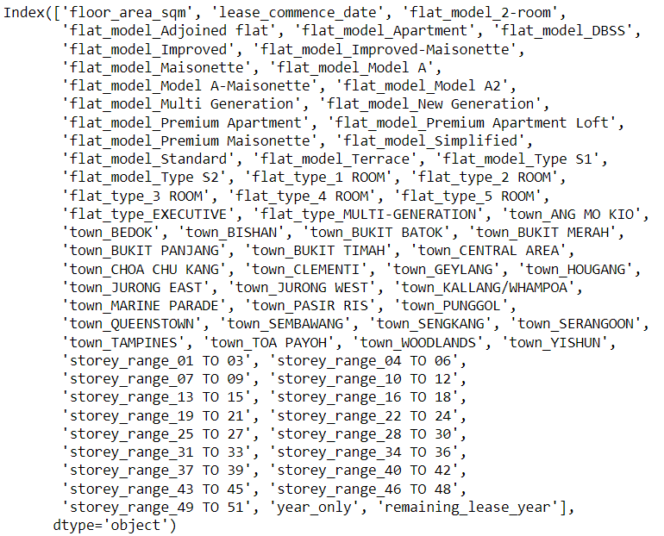

Feature selection
Forward Feature Selection used to determine the best R2 Scores
Encoding test 1
Encoding test 2

Slide 5
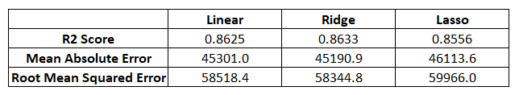
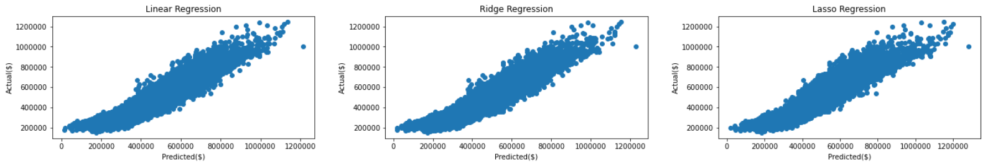
Regression Fitting
Linear Regression
Ridge Regression
Lasso Regression
Actual Vs Predicted resale price

Slide 6
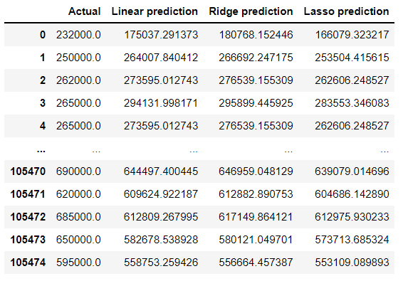
Predicting results
Predicting results after training model with Train Test Split

Slide 7
What's needed next ?
Recent data to compare prediction
Outlier removal
Test more models
More Data
Median income salary of buyers
HDB Valuation
Loan interest rates
Amenities (ex. supermarkets, transportation, schools)

